Slide 1



KEYNOTE
How Europe is Shaping the Future of Wireless Innovation
Ingrid Moerman & Jeroen Hoebeke
Notes:
Disclaimer

Slide 2
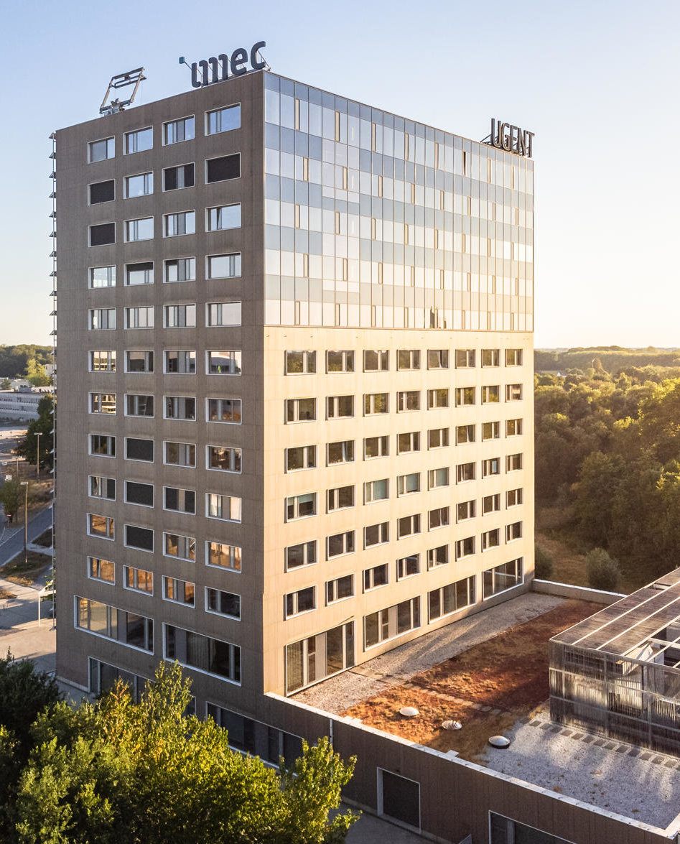
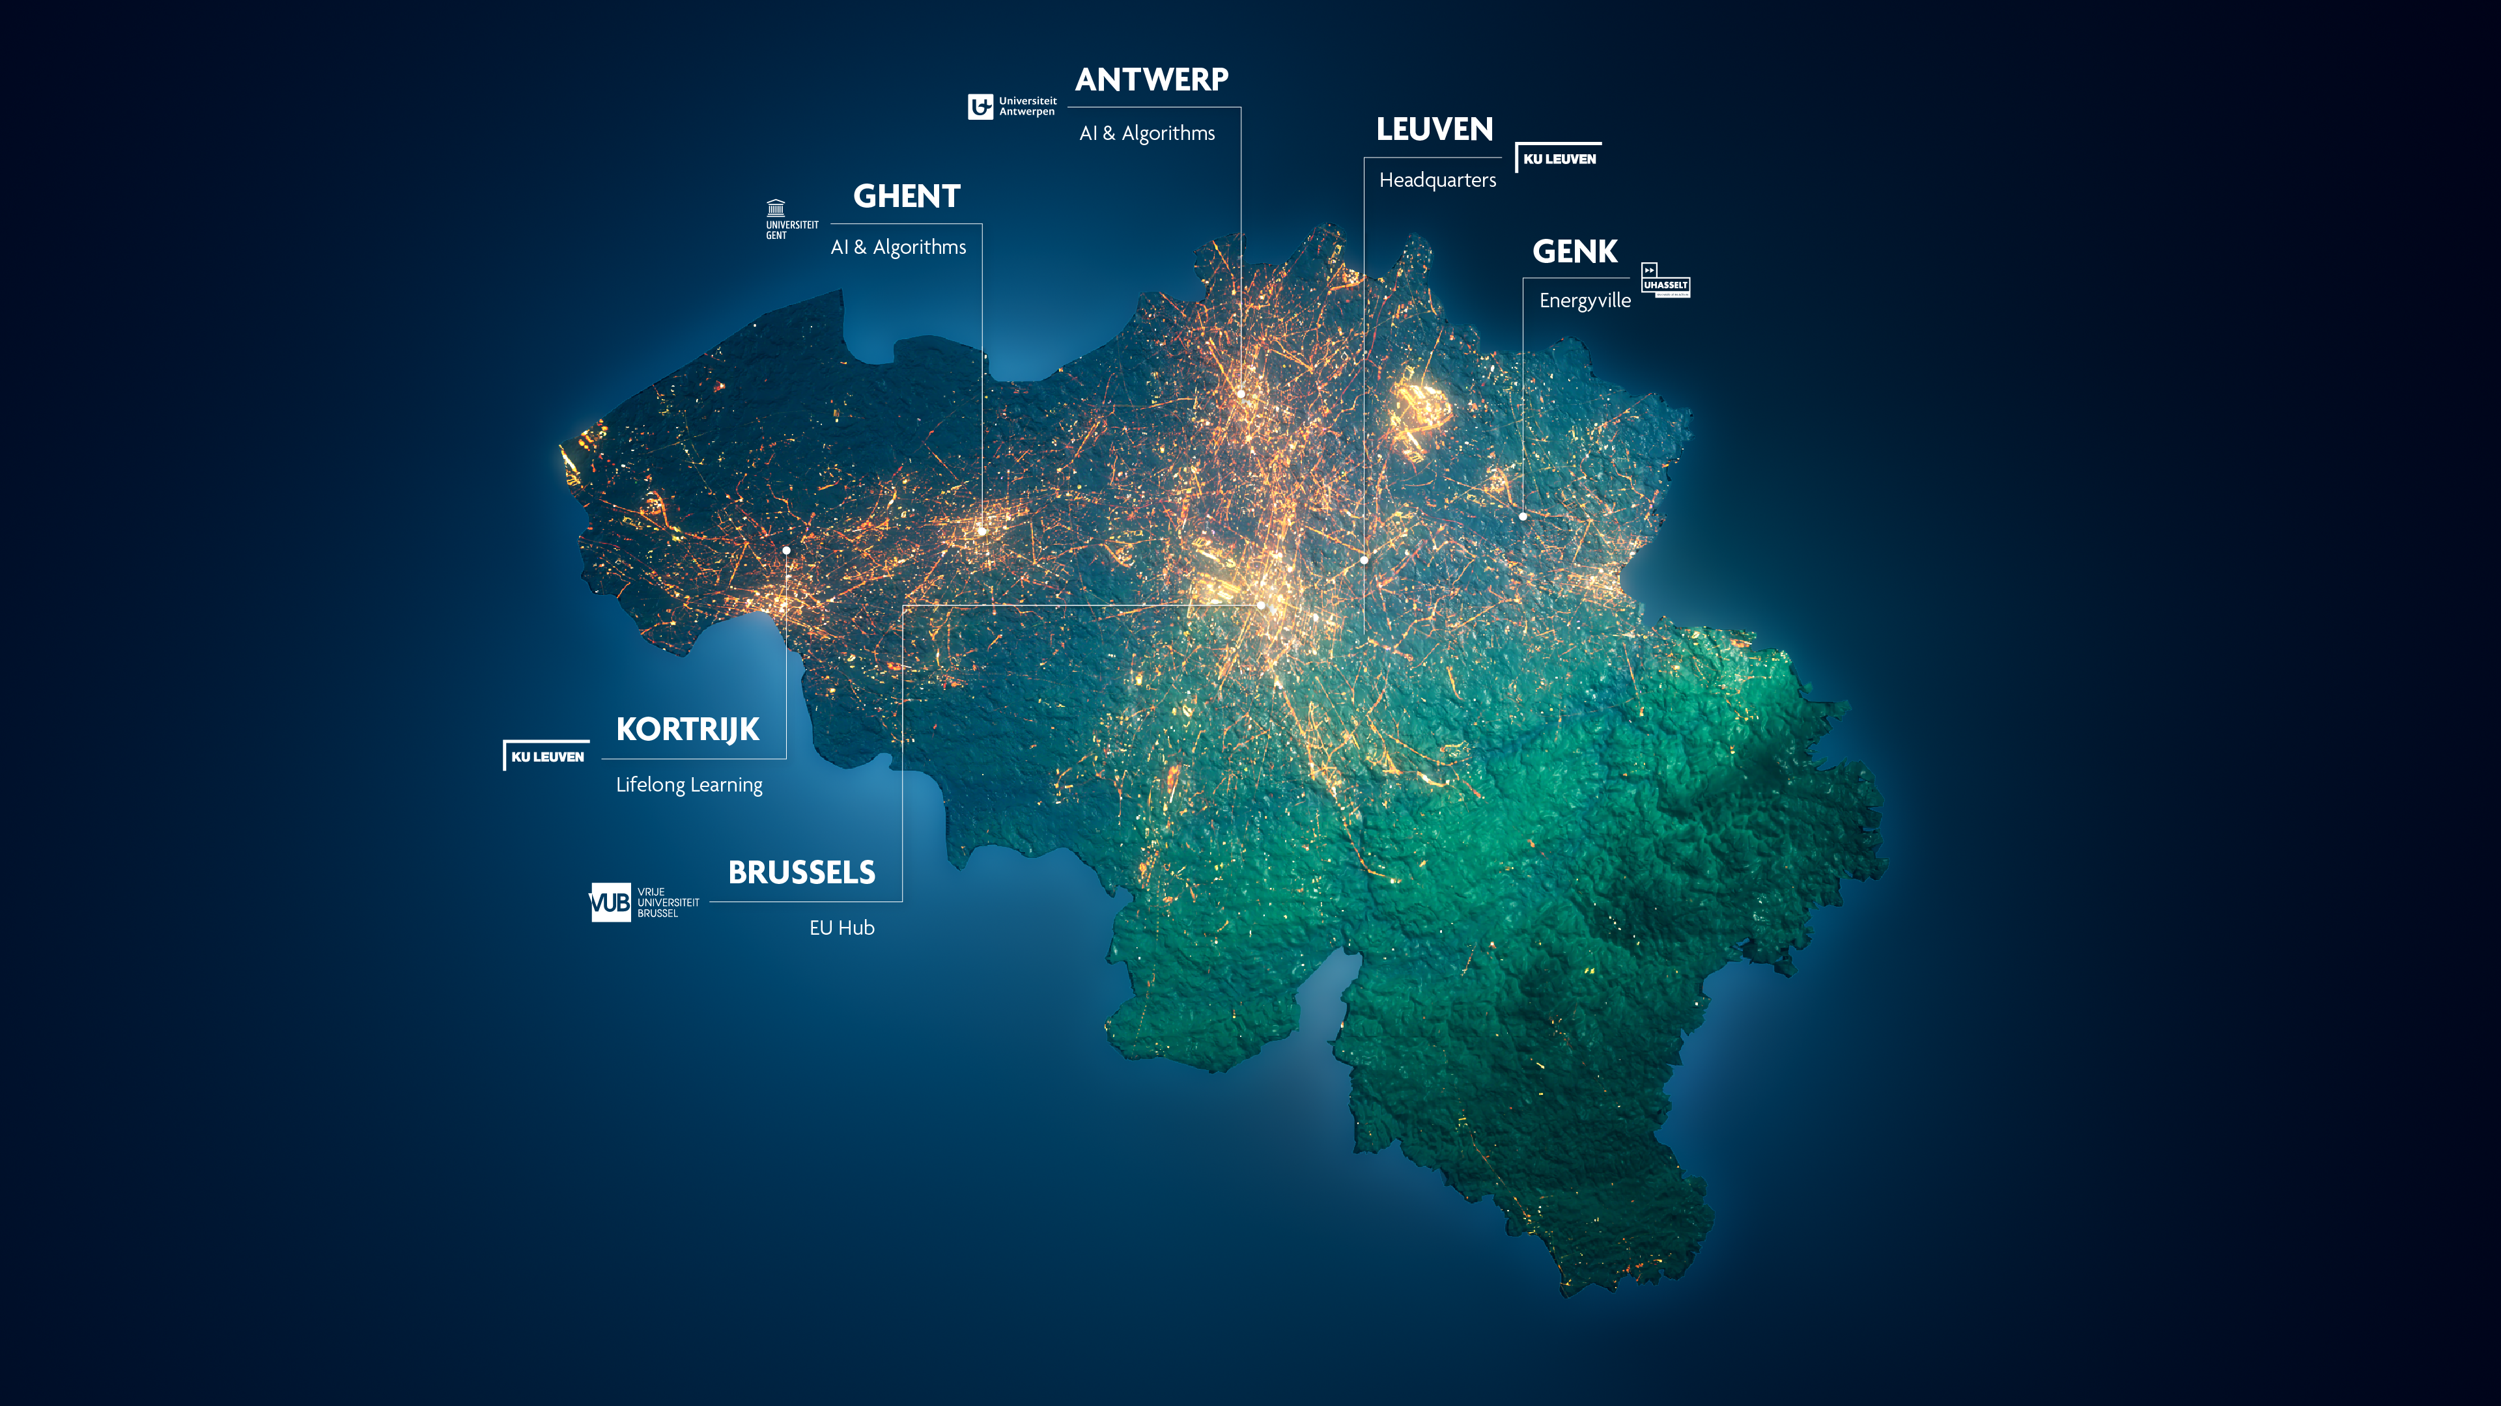


INTERNET
TECHNOLOGY & CONNECTIVITY
Foundations
System design
Applications
DATA
SCIENCE & AI
Notes:
The imec headquarters are located in Leuven, Flanders in Belgium.

Slide 3











Deterministic Connected Systems
Research program @ imec
Mass-market connectivity
Specialized connectivity
Deterministic
end-to-end communication
LESSONS LEARNED
Innovation based on mass-market infrastructure and chipsets is hard!
Notes:
Scope of the keynote -> driven by role as program manager DCS at imec + experience

Slide 4





Specialized connectivity needs
DETERMINISM = guaranteed and predictable END-to-END connectivity (infrastructure AND end-devices)
Beyond traditional metrics such as speed and capacity
Delivering firm, verifiable guarantees (beyond promises) on bounded latency, reliability, mobility, uniform coverage, scalability, security, resilience, ad-hoc deployment…
Also in complex, dynamic, and mobile environments
Meeting needs from (real-world) challenging applications in high-end professional use cases
Industrial automation
Social roboverse /Collaborative robotics
Automotive
Energy & power
Professional audio & video
Aerospace
Oil & gas
Holographic-type communications
Mission-critical communication
Tactile Internet
Transportation
Defence

Slide 5
Why is innovation based on mass-market connectivity infrastructure and chipsets so hard?

Slide 6
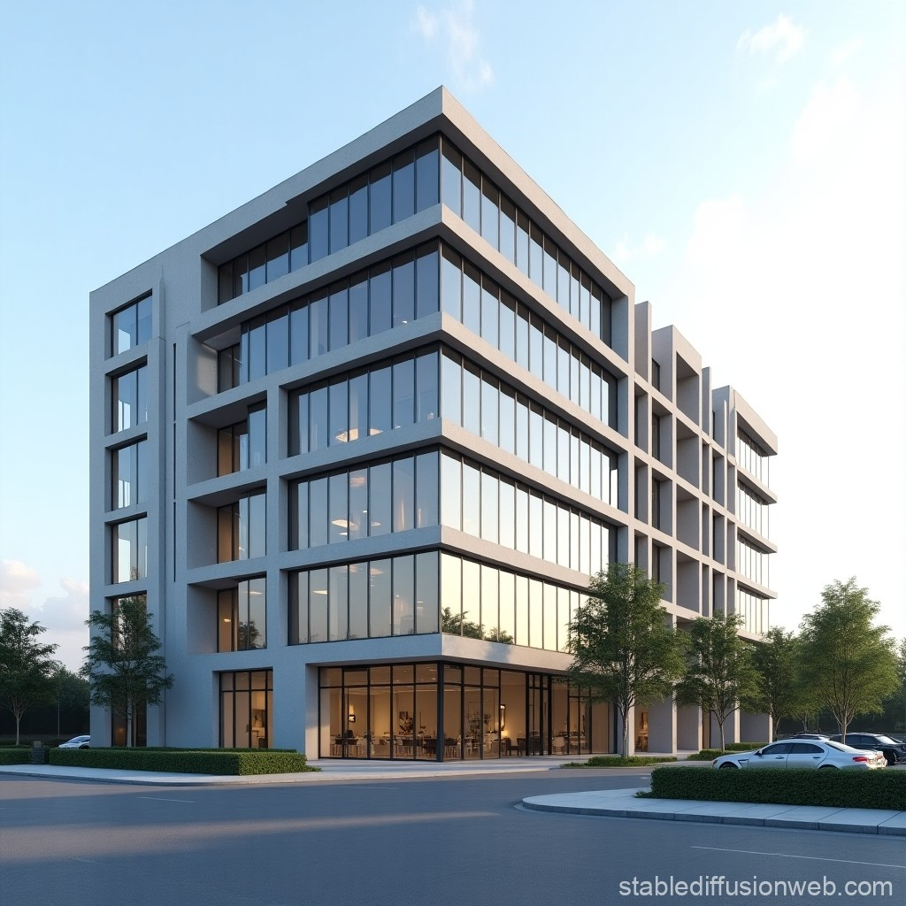



Standardisation landscape vs specialized connectivity needs
 |  |  | Specialized E2E connectivity needs
Ecosystem | One-size-fits-all complexity Many generations, releases, and new features with unknown mutual impact… |  | Solid baseline + specialization Simplification or focused complexity
Market | Large-volume consumer markets |  | Low-volume, high-end, professional markets
Features (limited by support in chipsets) | Driven by the market (revenue) High-speed, high-capacity, low-power… Mandatory features defined by certification |  | Driven by high-performance bounded latency, reliability, coverage, etc., e.g., OFDMA, MLO, AP coordination
Chipsets | Blackbox design - Limited control/exposure High-cost chip design, high-volume manufacturing |  | Whitebox design - Rich driver for control/exposure Lower-cost chip technology, low(er)-volume manufacturing
Coverage | Indoor (80-90% traffic) | Outdoor (10-20% traffic) | Indoor & outdoor (multi-RAT, multi-segment)
Deployment | Global interoperability Endless backward compatibility |  | Local private networks Greenfield deployment, customization (fit for purpose)
Specifications rising
from 5000 pages (2G, GSM)
to 200K pages (5G-advanced, Rel-18)
From 0.5 m to 20 m printed pages
[20 meter = about 6-story building]
Specifications
Actual deployment ➜
Simplifying radio connectivity
$$$
Notes:
https://www.linkedin.com/posts/howard-benn-fitp-fiet-71287832_how-many-pages-are-in-the-3gpp-specifications-activity-7203760503871913985-jl3C/
https://eshop.sectron.eu/en/5g-redcap-technology-the-future-of-iot-with-advanced-connectivity/a-7641/

Slide 7
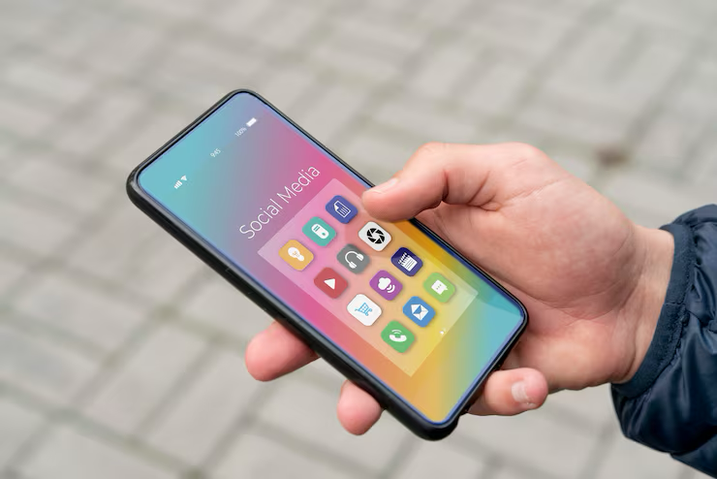

Standardisation landscape vs specialized connectivity needs
 |  |  | Specialized E2E connectivity needs
Ecosystem | One-size-fits-all complexity Many generations, releases, and new features with unknown mutual impact… |  | Solid baseline + specialization Simplification or focused complexity
Market | Large-volume consumer markets |  | Low-volume, high-end, professional markets
Features (limited by support in chipsets) | Driven by the market (revenue) High-speed, high-capacity, low-power… Mandatory features defined by certification |  | Driven by high-performance bounded latency, reliability, coverage, etc., e.g., OFDMA, MLO, AP coordination
Chipsets | Blackbox design - Limited control/exposure High-cost chip design, high-volume manufacturing |  | Whitebox design - Rich driver for control/exposure Lower-cost chip technology, low(er)-volume manufacturing
Coverage | Indoor (80-90% traffic) | Outdoor (10-20% traffic) | Indoor & outdoor (multi-RAT, multi-segment)
Deployment | Global interoperability Endless backward compatibility |  | Local private networks Greenfield deployment, customization (fit for purpose)

Slide 8


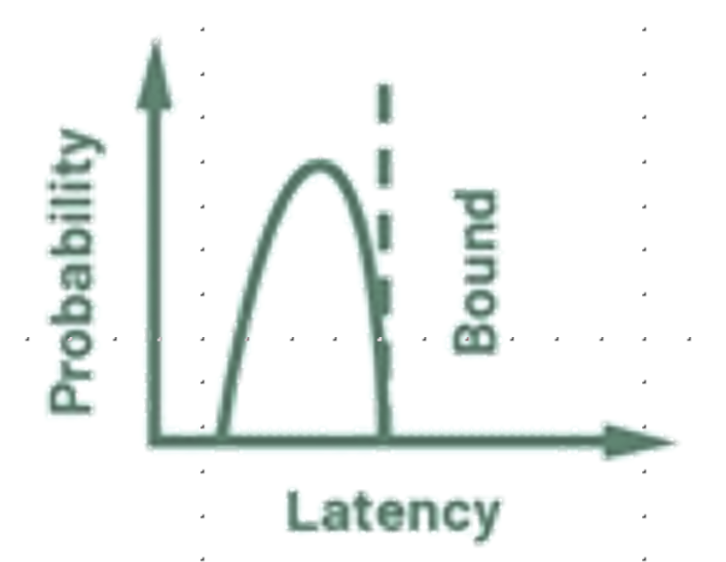
Standardisation landscape vs specialized connectivity needs
 |  |  | Specialized E2E connectivity needs
Ecosystem | One-size-fits-all complexity Many generations, releases, and new features with unknown mutual impact… |  | Solid baseline + specialization Simplification or focused complexity
Market | Large-volume consumer markets |  | Low-volume, high-end, professional markets
Features (limited by support in chipsets) | Driven by the market (revenue) High-speed, high-capacity, low-power… Mandatory features defined by certification |  | Driven by high-performance Bounded latency, reliability, coverage, etc., e.g., OFDMA, MLO, AP coordination
Chipsets | Blackbox design - Limited control/exposure High-cost chip design, high-volume manufacturing |  | Whitebox design - Rich driver for control/exposure Lower-cost chip technology, low(er)-volume manufacturing
Coverage | Indoor (80-90% traffic) | Outdoor (10-20% traffic) | Indoor & outdoor (multi-RAT, multi-segment)
Deployment | Global interoperability Endless backward compatibility |  | Local private networks Greenfield deployment, customization (fit for purpose)
Economies
of scale
Bounded latency

Slide 9
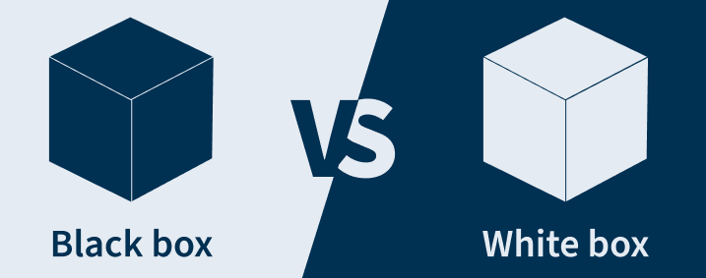
Standardisation landscape vs specialized connectivity needs
 |  |  | Specialized E2E connectivity needs
Ecosystem | One-size-fits-all complexity Many generations, releases, and new features with unknown mutual impact… |  | Solid baseline + specialization Simplification or focused complexity
Market | Large-volume consumer markets |  | Low-volume, high-end, professional markets
Features (limited by support in chipsets) | Driven by the market (revenue) High-speed, high-capacity, low-power… Mandatory features defined by certification |  | Driven by high-performance Bounded latency, reliability, coverage, etc., e.g., OFDMA, MLO, AP coordination
Chipsets | Black box design - Limited control/exposure High-cost chip design, high-volume manufacturing |  | White box design - Rich driver for control/exposure Lower-cost chip technology, low(er)-volume manufacturing
Coverage | Indoor (80-90% traffic) | Outdoor (10-20% traffic) | Indoor & outdoor (multi-RAT, multi-segment)
Deployment | Global interoperability Endless backward compatibility |  | Local private networks Greenfield deployment, customization (fit for purpose)

Slide 10
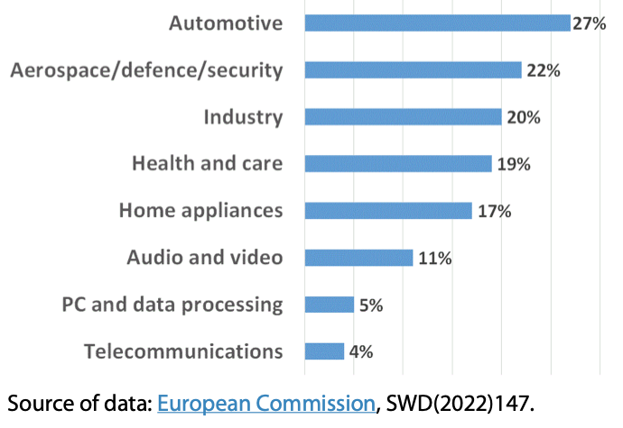
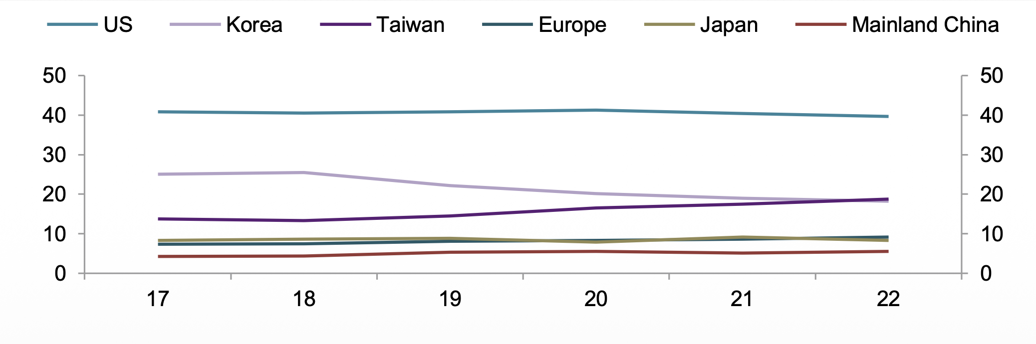
Global semiconductor manufacturing and value-chain landscape
Some observations (1)
Europe's share in global fabrication capacity is below 10%, and in chip design below 2%
Very low share of fabrication for telecommunications
Global market share of the semiconductors’ supply chain
(design & foundries)
Europe's market shares in chips
production for different sectors
Kleiner, T., Rodríguez, A.G. (eds) The Making of a Global Digital Rulebook. Palgrave Macmillan, Singapore. European commission, SWD (2022) 147
https://www.europarl.europa.eu/RegData/etudes/BRIE/2022/733596/EPRS-Briefing-733596-EU-chips-act-V2-FINAL.pdf

Slide 11
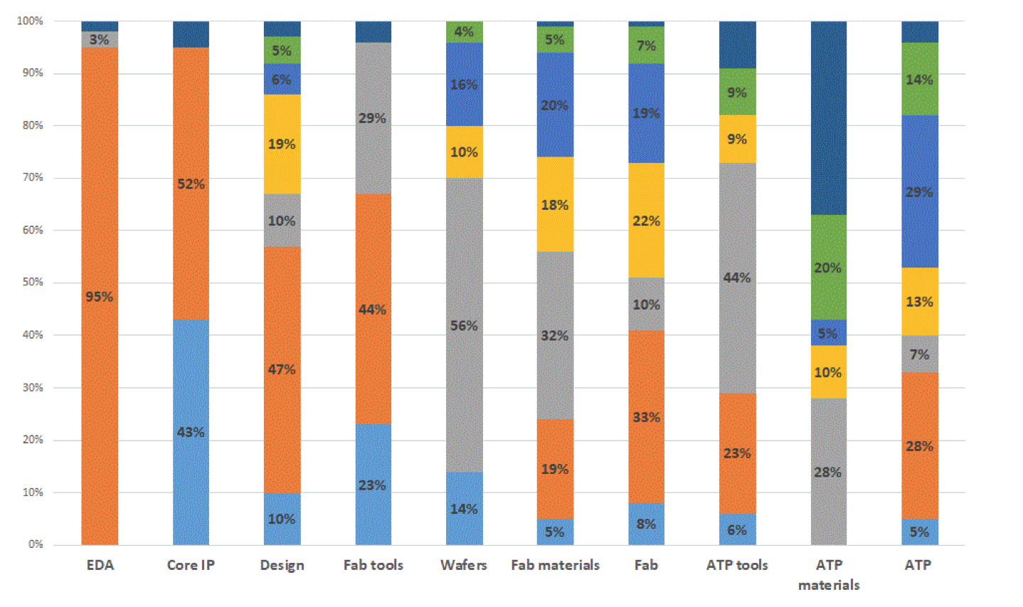




Global semiconductor manufacturing and value-chain landscape
Some observations (2)
Heavy reliance on the US for design and on Asia for manufacturing!
EU is strong in the provision of fabrication tools and core IP blocks, but lags in many other segments
Global market shares in the different segments along the chips value chain
Asia
Europe
United States
Japan
South Korea
Taiwan
China
Other
US
https://www.europarl.europa.eu/RegData/etudes/BRIE/2022/733596/EPRS-Briefing-733596-EU-chips-act-V2-FINAL.pdf
Notes:
Electronic design automation (EDA) is a category of software, hardware, and services used to design, simulate, verify, and manufacture complex electronic systems like integrated circuits (chips) and printed circuit boards (PCBs)
In semiconductor engineering, an IP Core (Intellectual Property Core) is a reusable, pre-designed, and pre-verified unit of logic, cell, or integrated circuit layout design. Instead of designing a microchip entirely from scratch, engineers use these blocks as plug-and-play components to create complex System-on-Chip (SoC) and Application-Specific Integrated Circuit (ASIC) designs
ATP in semiconductor manufacturing stands for Assembly, Testing, and Packaging, representing the crucial back-end processes that transform raw silicon wafers into finished, working microchips

Slide 12
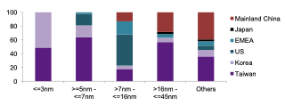





Global semiconductor manufacturing and value-chain landscape
Some observations (3)
For advanced technologies (the 7- and 5-nm nodes), 100 % of global capacity is based in East Asia (Taiwan and South Korea).
Only TSMC (Taiwan) and Samsung (South Korea) can manufacture chips at 5nm, and the global economy relies on Taiwan for 92 % of the production of these chips.
Chip designers
Global: share of fabrication capacity of foundries
EUV litho
Dominance by a few big global players
≤ 3nm 5nm-7 nm 7-16nm 16-45nm Others
Increasing complexity & chip design cost
Most advanced chips
Can EU compete?
Increasing maturity
Kleiner, T., Rodríguez, A.G. (eds) The Making of a Global Digital Rulebook. Palgrave Macmillan, Singapore. European commission, SWD (2022) 147
Notes:
Driven by economies of scale -> no interest in small volumes!

Slide 13
Standardisation landscape vs specialized connectivity needs
 |  |  | Specialized E2E connectivity needs
Ecosystem | One-size-fits-all complexity Many generations, releases, and new features with unknown mutual impact… |  | Solid baseline + specialization Simplification or focused complexity
Market | Large-volume consumer markets |  | Low-volume, high-end, professional markets
Features (limited by support in chipsets) | Driven by the market (revenue) High-speed, high-capacity, low-power… Mandatory features defined by certification |  | Driven by high-performance Bounded latency, reliability, coverage, etc., e.g., OFDMA, MLO, AP coordination
Chipsets | Black box design - Limited control/exposure High-cost chip design, high-volume manufacturing |  | White box design - Rich driver for control/exposure Lower-cost chip technology, low(er)-volume manufacturing
Coverage | Indoor (80-90% traffic) | Outdoor (10-20% traffic) | Indoor & outdoor (multi-RAT, multi-segment)
Deployment | Global interoperability Endless backward compatibility |  | Local private networks Greenfield deployment, customization (fit for purpose)
No interest from big global players to open up black box for small volumes!
Time to move away from ‘economies of scale’ law to realize focused complexity
Notes:
Move away from traditional way of thinking about ‘economies of scale’

Slide 14
Standardisation landscape vs specialized connectivity needs
 |  |  | Specialized E2E connectivity needs
Ecosystem | One-size-fits-all complexity Many generations, releases, and new features with unknown mutual impact… |  | Solid baseline + specialization Simplification or focused complexity
Market | Large-volume consumer markets |  | Low-volume, high-end, professional markets
Features (limited by support in chipsets) | Driven by the market (revenue) High-speed, high-capacity, low-power… Mandatory features defined by certification |  | Driven by high-performance Bounded latency, reliability, coverage, etc., e.g., OFDMA, MLO, AP coordination
Chipsets | Black box design - Limited control/exposure High-cost chip design, high-volume manufacturing |  | White box design - Rich driver for control/exposure Lower-cost chip technology, low(er)-volume manufacturing
Coverage | Indoor (80-90% traffic) | Outdoor (10-20% traffic) | Indoor & outdoor (multi-RAT, multi-segment)
Deployment | Global interoperability Endless backward compatibility |  | Local private networks Greenfield deployment, customization (fit for purpose)
Why ignoring Wi-Fi –based research and innovation in EU, while more and more traffic is carried by Wi-Fi?
Coverage (and reliability) is limited by spectrum/regulation, not by technology
Notes:
Poor indoor coverage of 5G indoor

Slide 15
Standardisation landscape vs specialized connectivity needs
 |  |  | Specialized E2E connectivity needs
Ecosystem | One-size-fits-all complexity Many generations, releases, and new features with unknown mutual impact… |  | Solid baseline + specialization Simplification or focused complexity
Market | Large-volume consumer markets |  | Low-volume, high-end, professional markets
Features (limited by support in chipsets) | Driven by the market (revenue) High-speed, high-capacity, low-power… Mandatory features defined by certification |  | Driven by high-performance Bounded latency, reliability, coverage, etc., e.g., OFDMA, MLO, AP coordination
Chipsets | Black box design - Limited control/exposure High-cost chip design, high-volume manufacturing |  | White box design - Rich driver for control/exposure Lower-cost chip technology, low(er)-volume manufacturing
Coverage | Indoor (80-90% traffic) | Outdoor (10-20% traffic) | Indoor & outdoor (multi-RAT, multi-segment)
Deployment | Global interoperability Endless backward compatibility |  | Local private networks Greenfield deployment, customization (fit for purpose)
Endless backward compatibility is blocking innovation and not a prime concern in private deployments

Slide 16
Have we reached a dead end for wireless innovation in Europe?

Slide 17
Today’s research & Innovation in Europe today
Shaped by global players in Europe
  [Fabrication tools: ASML (EU Chips Act and Chips-JU)]
  Wireless connectivity: Nokia, Ericsson (SNS-JU, CELTIC-NEXT…)
    Focus on infrastructure and software: cloudification, virtualisation, disaggregation, decoupling…
    Limited focus on low-level wireless technology enablers and end devices: no EU global players
Focus on large volumes
  [Fabrication tools: focus on data centers for AI & optical interconnect]
  Wireless connectivity: main focus on eMBB infrastructure, no progress with URLLC
Blocking factor for guaranteeing End-to-End connectivity performance!
Complex one-size-fits-all ecosystem cannot meet specialized connectivity needs
“Chicken-and-egg" problem: not investing too far ahead of demand
https://www.politico.eu/article/europeans-missing-out-5g-data-shows-smartphone-internet-innovation/
5G deployments are only affordable for larger enterprises, not for 99.8% of small and medium-sized enterprises in EU, employing about 2/3 of the active population
https://ec.europa.eu/eurostat/statistics-explained/index.php?title=Structural_business_statistics_overview:
Notes:
SW focus: cloudification, virtualisation, disaggregation, decoupling…
https://ec.europa.eu/eurostat/statistics-explained/index.php?title=Structural_business_statistics_overview:
33.1 million enterprises were active in the EU in 2023, employing 162.2 million persons. Of that total, 99.8% were small and medium-sized enterprises, which employed almost two-thirds of the active population in the EU business economy.

Slide 18
Or is this an opportunity to reshape the future?

Slide 19
Reshaping the future for wireless research & innovation
Yes, we can!
We must recognize that
  Requirements of professional environments are not (always) the same as consumer ones.
  Local operation is more important than endless backwards compatibility: all we need is a limited set of relevant features promoting predictable and stable behaviour
  There is no innovation without transparency: no black-box behaviour, but white-box behaviour, enabling fine-grained control and customisation
  Small, medium, and mid-size enterprises need affordable connectivity solutions
  We cannot ignore Wi-Fi as a complementary technology for 5G
No more prejudices
  There is playground for specialized communication solutions and chips
  Move away from ‘economies of scale’ thinking and invest in sovereign solutions that can be designed and produced in smaller volumes in Europe
  We have, besides cloud, software and AI, also chip design and system-level competences in Europe to build end-to-end connectivity solutions
Small-scale innovation today can have a global impact on a large scale in future

Slide 20
Wi-Fi innovation platform for End-to-End specialized connectivity
Notes:
Openwifi as an example of open innovation platform for specialized connectivity

Slide 21








…
8
UNDERSTAND
INNOVATE
Usage and management of new features is left open.
Complex to assess real-life impact at design time.
A viable candidate for wireless TSN
High data rate for fast Tx
Natural extension of IEEE 802.1 TSN
New features addressing TSN needs
Cost-effective, lightweight architecture
No indoor environment without Wi-Fi
Can run in local licensed spectrum
New capabilities beyond communication such as localization & sensing.
Notes:
New Wi-Fi generations introduce tens of novel features to move to high-effiency (Wi-Fi 6), extremely high throughput (Wi-Fi 7) and ultra-high reliability (Wi-Fi 8).
Also: Big gap between what industry needs and what 5G offers

Slide 22

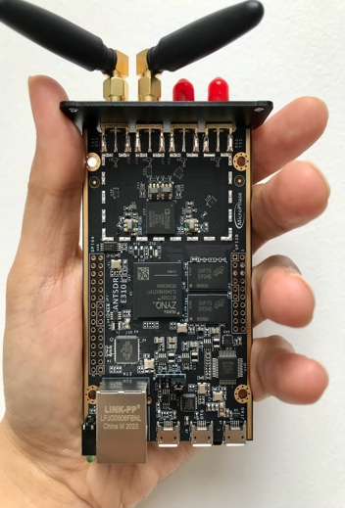





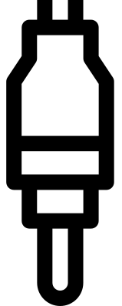
Customizable Wi-Fi running on system-on-chip FPGA platforms
White-box full-stack design: from digital baseband to linux driver
High-end FPGA platforms are used in SDR commercial products
Linux: driver & low-level SDR control
Single chip, combining radio/network/application processing
System-on-Chip
High
MAC
PHY +
low
MAC
RF FE
processor
CPU
High-speed on-chip bus: ping RTT of 300μs (vs 1ms in COTS Wi-Fi )
FPGA
Reprogrammable hardware allowing full low-level customization
Baseline openwifi implementation: subset of Wi-Fi features available under AGPLv3 (https://github.com/open-sdr/openwifi)
Selected standard-compliant + advanced pre/non-standard (TSN) features: available via subscription model (https://openwifi.tech)
& bilateral collaborations

Slide 23
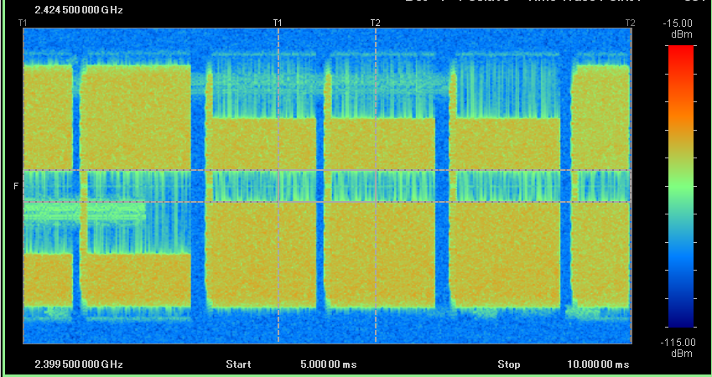
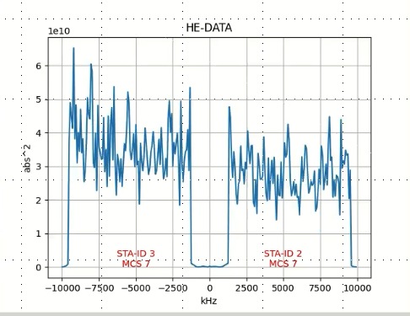
Multi-User OFDMA - Flexible control beyond black-box COTS
Cross-Technology Interference Awareness
No interference: 4 Wi-Fi users

Slide 24
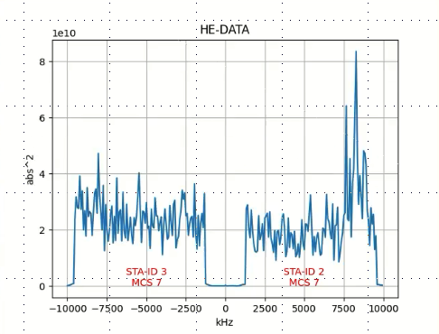
Multi-User OFDMA - Flexible control beyond black-box COTS
Cross-Technology Interference Awareness
LR-WPAN
LR-WPAN
Detection of narrowband interference

Slide 25
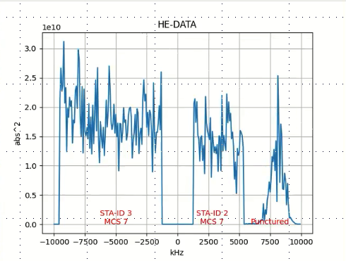
Multi-User OFDMA - Flexible control beyond black-box COTS
Cross-Technology Interference Awareness for improved coxistence
LR-WPAN
LR-WPAN
Mitigation of interference by
RU puncturing and RU re-allocation

Slide 26
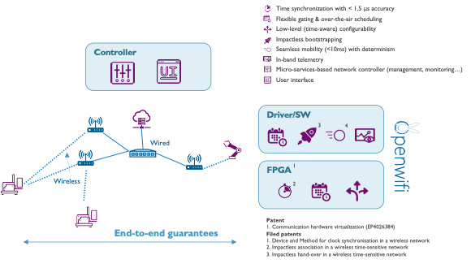
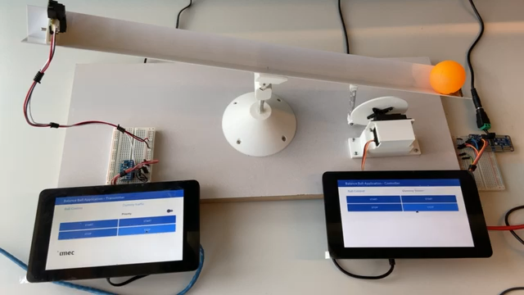
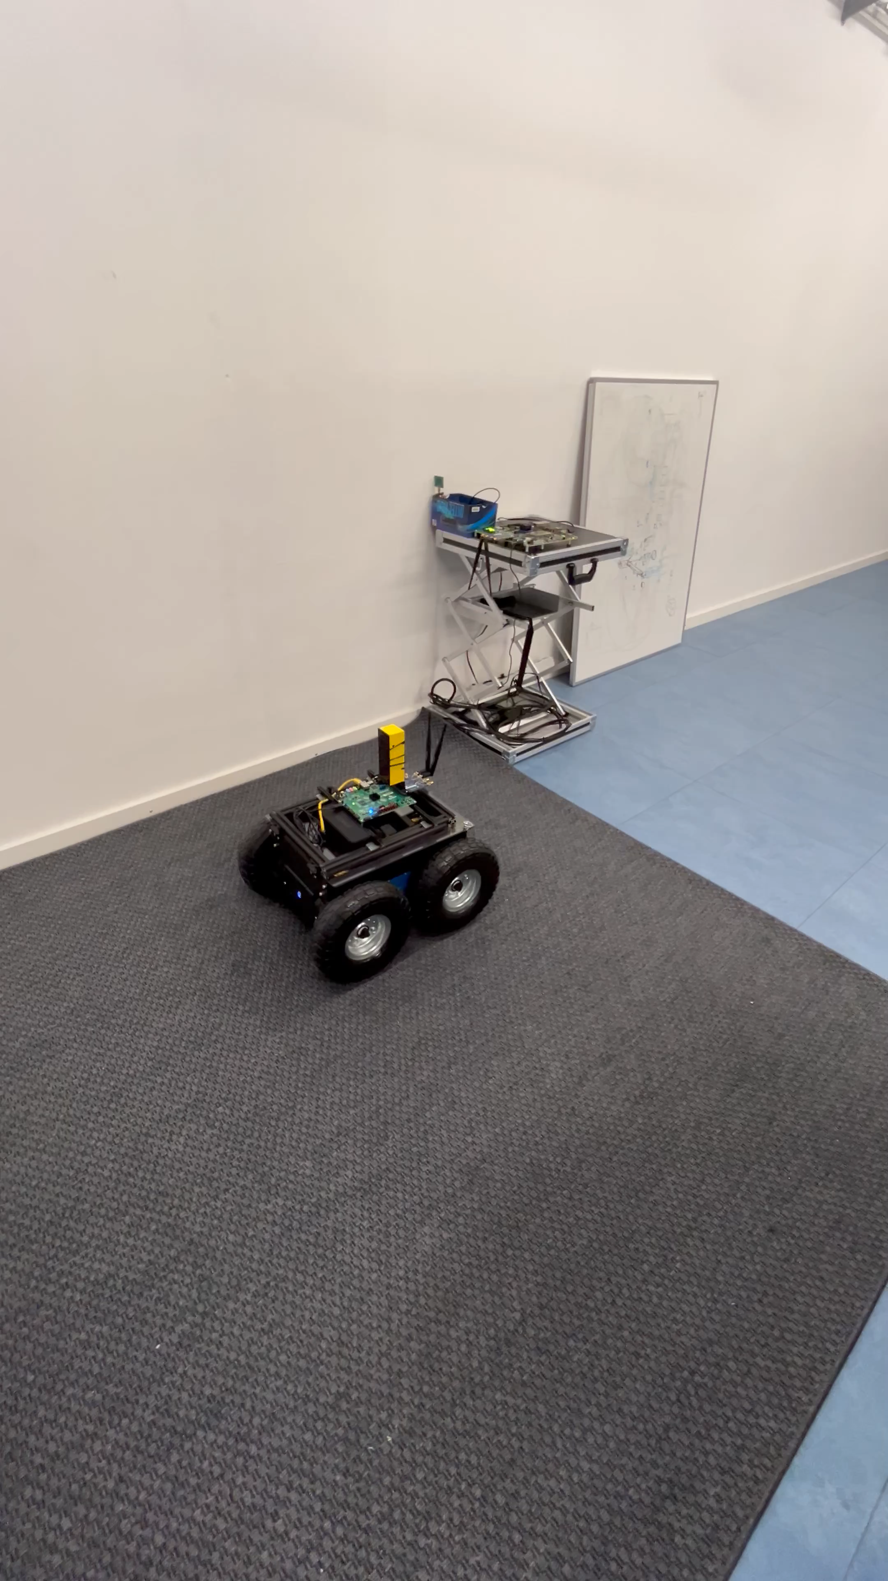
Wireless Time-Sensitive Networking (TSN)
Advanced non/pre-standard features
► Bounded E2E latency < 3.25 ms
► Handover delay < 9 ms
(0 ms with MLO)

Slide 27
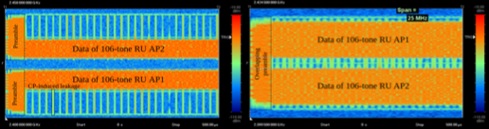
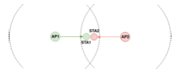

Coordinated OFDMA (Wi-Fi 9)
Anticipating new standards: enabled by TSN
OFDMA
50 MHz (2 channels)
AP1 + AP2
25 MHz (1 channel)
Note: CW not shown
Thijs Havinga, Xianjun Jiao, Wei Liu, Baiheng Chen, Robbe Gaeremynck, Ingrid Moerman, WiNTECH ‘25, Proceedings of the ACM Workshop on Wireless Network Testbeds, Experimental evaluation & Characterization, pp 41-48, Best paper award
co-OFDMA
< 50 ns synchronisation accuracy across APs

Slide 28
Take away
Start small, think big - Let’s build EU sovereign wireless technology & End-to-End systems!
Many remaining challenges for high-performance wireless connectivity
Specialized front-end design
Chip architectures promoting flexible design (e.g. chiplets)
Software – hardware co-design
Time-Sensitive Networking
Resilience
Trustworthy (edge) AI
Hardware-supported security
End-to-end, system-level PoC validation in realistic environments
…
Notes:
Openwifi is just one example, realized by a smaller team -> also applicable to other technologies and domains

Slide 29

Contact: ingrid.moerman@imec.be
Openwifi

