Slide 1



CELTIC-NEXT
Innovate UK Summer Briefing
20th August 2019, London
MmWave Devices and Systems for Mobile Industrial Internet of Things
[DS-MI²oT]
Dr Jaswinder Lota
j.lota@uel.ac.uk, j.lota@ucl.ac.uk

Slide 2

Teaser
What is the main benefit of the idea/proposal?
Key technology enabler for MmWave Cellular IoT
What makes the added value?
Hardware-informed algorithms together with the circuits, for the particular MI²oT challenges that require combined data transmission and localisation.
Why should I participate in the project?
Enable headstart for next generation mmWave cellular IoT
www.celticnext.eu DS-MI²oT, J. Lota, UEL, UCL, j.lota@uel.ac.uk, j.lota@ucl.ac.uk

Slide 3
Organisation Profile
Dr Jaswinder Lota SMIEEE, FHEA
Reader in Communications & Signal Processing
Connected Devices and Systems
Department of Engineering & Computing
University of East London, London E16 2RD UK
j.lota@uel.ac.uk
Sensors Circuits and Systems
Department of Electronic & Electrical Engineering (Hon)
University College London, London WC1E 7JE
j.lota@ucl.ac.uk
Christos Masouros* Prof Andreas Demosthenous˥ FIEEE
Assoc. Prof
Sensors Circuits and Systems
Department of Electronic & Electrical Engineering (Hon)
University College London, London WC1E 7JE
*c.masouros@ucl.ac.uk, ˥ a.demosthenous@ucl.ac.uk
Research draws together expertise from two leading Wireless Communications and Circuits groups in University College London (UCL) and University of East London (UEL
UCL is committed to supporting collaborative research in wireless communications by, for instance, being part of the £1.13M 2009-2012 project “UK-China Science Bridges: R&D on
B4G Wireless Mobile Communications” funded by RCUK, and as a member of the industrially led WWRF forum, dedicated to addressing societal challenges through wireless communications.
Recently, Aeroflex Inc. (USA) donated £1.5M worth of network development equipment toward the establishment of the Wireless Laboratory at UCL, providing unique facilities for
hands-on research in LTE/5G technologies, that will serve as the experimentation platform of this project...
UEL has been successful in obtaining FP7 and H2020 grants in excess of over £6M for ICT and KTPs (2018-21) amounting to £1M, including for signal processing and
digital design/hardware acceleration.
www.celticnext.eu DS-MI²oT, J. Lota, UEL, UCL, j.lota@uel.ac.uk, j.lota@ucl.ac.uk

Slide 4

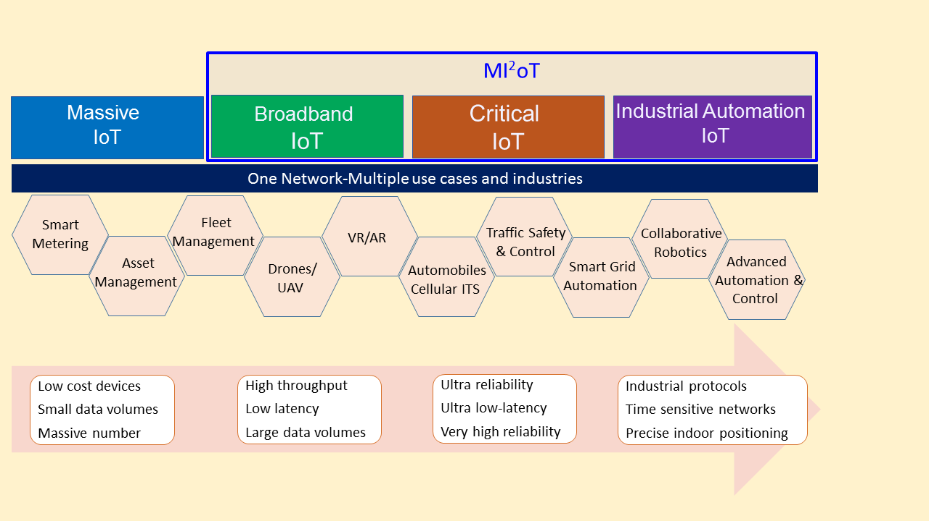
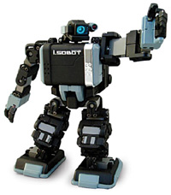
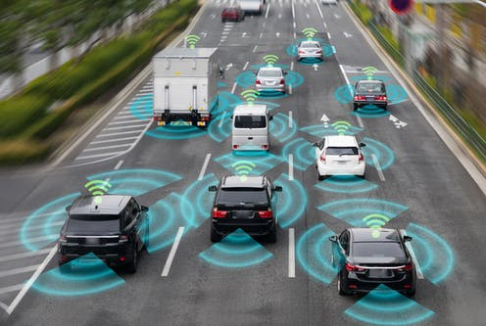
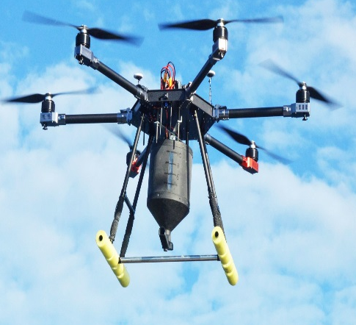

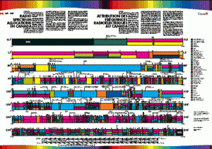
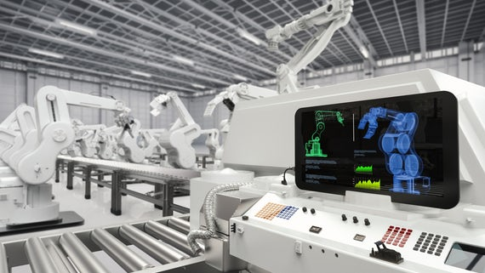

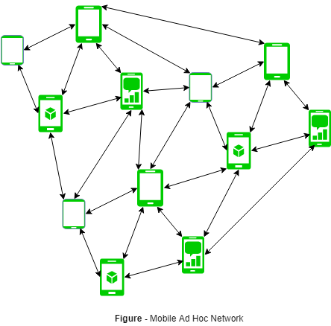
Proposal Introduction (1)
Complex IoT Devices will require
Higher spectral efficiency 30/-15 bps/Hz
with reduced latency.
Ultra-reliable low-latency communications
(URLCC) Real-time control of machines
for greater number of machines
connected to IoT.
Directional transmission
HD video (Drones-insurance claims)
Contiguous, broader and harmonized frequency bands across countries.
for further expanding the capability of Broadband IoT.
Currently different countries different bandwidth, leads to
interference and device complexity
FoF: High location accuracy 5m-20 cm.
Radar sensors can locate, but , cannot communicate
NB IoT/LTE-M
Public Safety D2D adhoc mobile network
5GNR Rel-16 will allocate above 6 GHz f(MmWave) frequencies to facilitate 5× increase in capacity, and ~23× faster response (as compared to the current 4G network) with 1.4 GB/s of median of browsing speed
www.celticnext.eu DS-MI²oT, J. Lota, UEL, UCL, j.lota@uel.ac.uk, j.lota@ucl.ac.uk

Slide 5

Proposal Introduction (1)
CHALLENGES ADDRESED AT UEL, UCL
Fast Beam switching
CSI-robust transmission with analog codebooks, even non-coherent transmission
Novel strategies for hybrid beamforming with low-resolution DACs/ADCs
that can lower the power consumption
Joint accurate localisation and mmWave data rate transfer
Low power ASIC for Doppler and Range Computation
www.celticnext.eu DS-MI²oT, J. Lota, UEL, UCL, j.lota@uel.ac.uk, j.lota@ucl.ac.uk

Slide 6
Proposal Introduction (2)
Impact:
A paradigm shift in the design of MI²oT devices by jointly designing hardware-informed algorithms together with the circuits, for the particular MI²oT challenges that require combined data transmission and localisation.
www.celticnext.eu DS-MI²oT, J. Lota, UEL, UCL, j.lota@uel.ac.uk, j.lota@ucl.ac.uk

Slide 7
Partners
Existing consortium UEL, UCL.
Expertise, profiles and types of partners we are looking for:
Autonomous vehicles, mobile robots and drones.
www.celticnext.eu DS-MI²oT, J. Lota, UEL, UCL, j.lota@uel.ac.uk, j.lota@ucl.ac.uk

Slide 8
Contact Info
For more information and for interest to participate please contact:
Dr Jaswinder Lota
j.lota@uel.ac.uk, j.lota@ucl.ac.uk
Telephone 02082232131

