Slide 1


CELTIC-NEXT
Innovate UK Summer Briefing
20th August 2019, London
Pitch of the Project Proposal
5G Air to Ground Connectivity
Jean-Christophe Schiel / Airbus Defence and Space
Jean-Christophe.Schiel@airbus.com

Slide 2


Teaser
Growing demand for ubiquitous broadband connectivity for all type of flying platform → 5G Air to Ground Connectivity:
  Commercial aircrafts are usually using the satellite communication to offer connectivity to the passengers
    Currently €€€ but it is improving (LEO satellites)
    Still the only solution when flying above the oceans → natural complement of LEO satellites
  The idea is then to add Air-to-Ground connections when available to offer more connectivity at a lower cost and to benefit from the 5G technology.
www.celticnext.eu 5G A2G Connectivity – Jean-Christophe Schiel

Slide 3

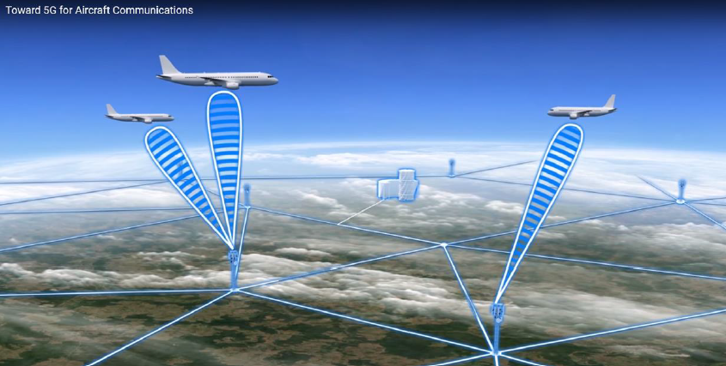
Proposal Introduction (1)
The idea is to connect an aircraft like a 5G user on the Ground
But an aircraft is NOT a conventional user
  Altitude: 10000ft-40000ft @ up to 1000km/h
  Modifications
                on the 5G Airborne SDR modem
                On the Base Stations
                On the antennas
                On some protocols (handover …)
  It needs Flight Certification or at least
  the minimal requirements the fly in an aircraft: EMC, environmental, fire & explosion proof etc … for a prototype
www.celticnext.eu 5G A2G Connectivity – Jean-Christophe Schiel

Slide 4
Proposal Introduction (2)
Expected benefits:
  Higher data rates
  Low latency
  Cheaper
  Good service availability in dense areas
  Worldwide standard
Challenge and Weakness:
  Doppler, latency, base station hand over
  Can’t cover the oceans and the low density areas (TBC)
  Radio or system prototype prepared for flight test
Project Duration could be 36 months
Project outcome: ideally a demonstrator with a prototype of a modem with flight tests (dependant of Airbus internal funding)
www.celticnext.eu 5G A2G Connectivity – Jean-Christophe Schiel

Slide 5
Partners
No Consortium for the moment only a fresh idea
Profiles and type of partners:
Telco operator / Service Provider for the overall system view
Telecommunication equipment manufacturer for
  5G Base station
  Airborne Antenna (beamforming, patch …)
  SDR flight certifiable Modem side
www.celticnext.eu 5G A2G Connectivity – Jean-Christophe Schiel

Slide 6


Contact Info
For more information and for interest to participate please contact:
Jean-Christophe Schiel
Airbus Defence and Space
Jean-Christophe.Schiel@airbus.com
Phone: +33 6 73 69 38 38
1 Bld Jean Moulin
78990 Elancourt
France
www.airbus.com
                Presentation available via:

Slide 7

Join the follow-up Telco
11 September 10-10.30 CET
Meeting number (access code): 955 745 706
Meeting password: ZexxcKJQ
Join the Meeting:
https://eurescom-meetings.webex.com/eurescom-meetings/j.php?MTID=me9dbf557f6ccb5aebc0788888f25e9f3
Join by phone
+49-6925511-4400 Germany toll
Global call-in numbers
Can't join the meeting?
www.celticnext.eu office@celticnext.eu

