Slide 1
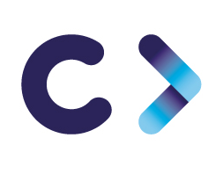

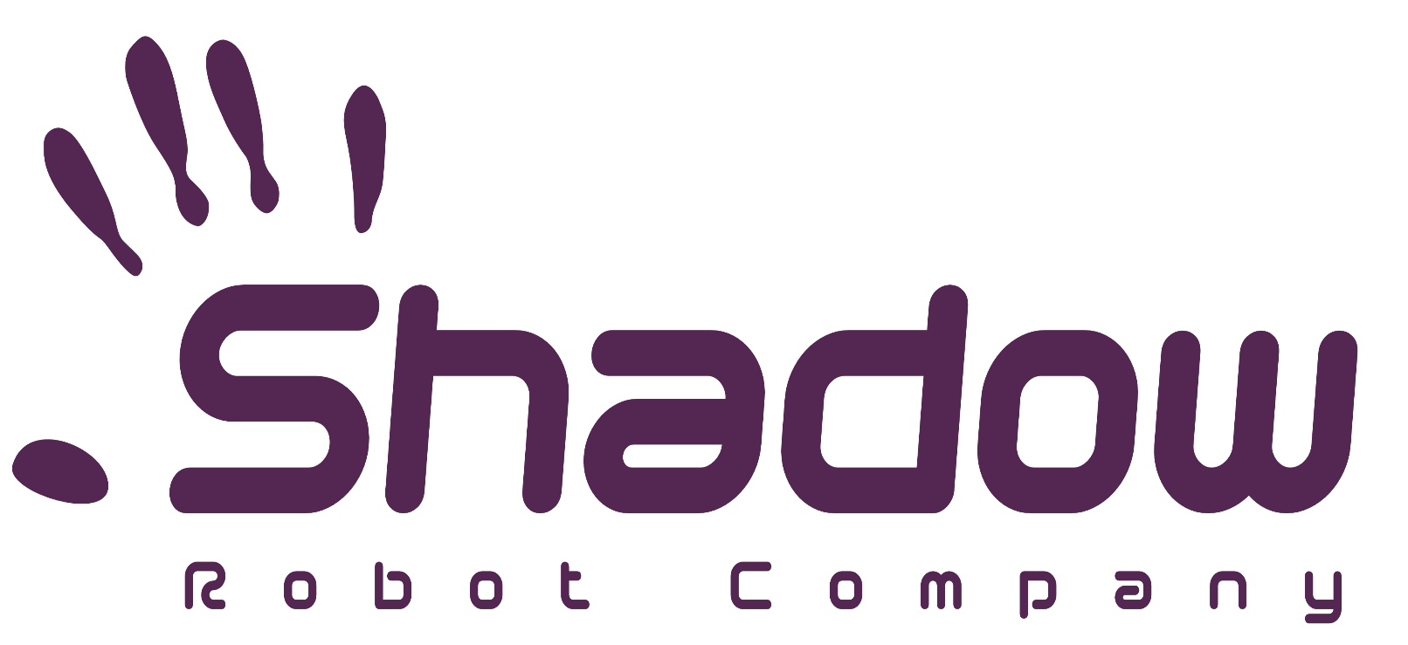
CELTIC-NEXT
Innovate UK Summer Briefing
20th August 2019, London
Pitch of the Project Proposal
Shadow Robot
Radhika Gudipati Shadow Robot Company Ltd
radhika@shadowrobot.com

Slide 2

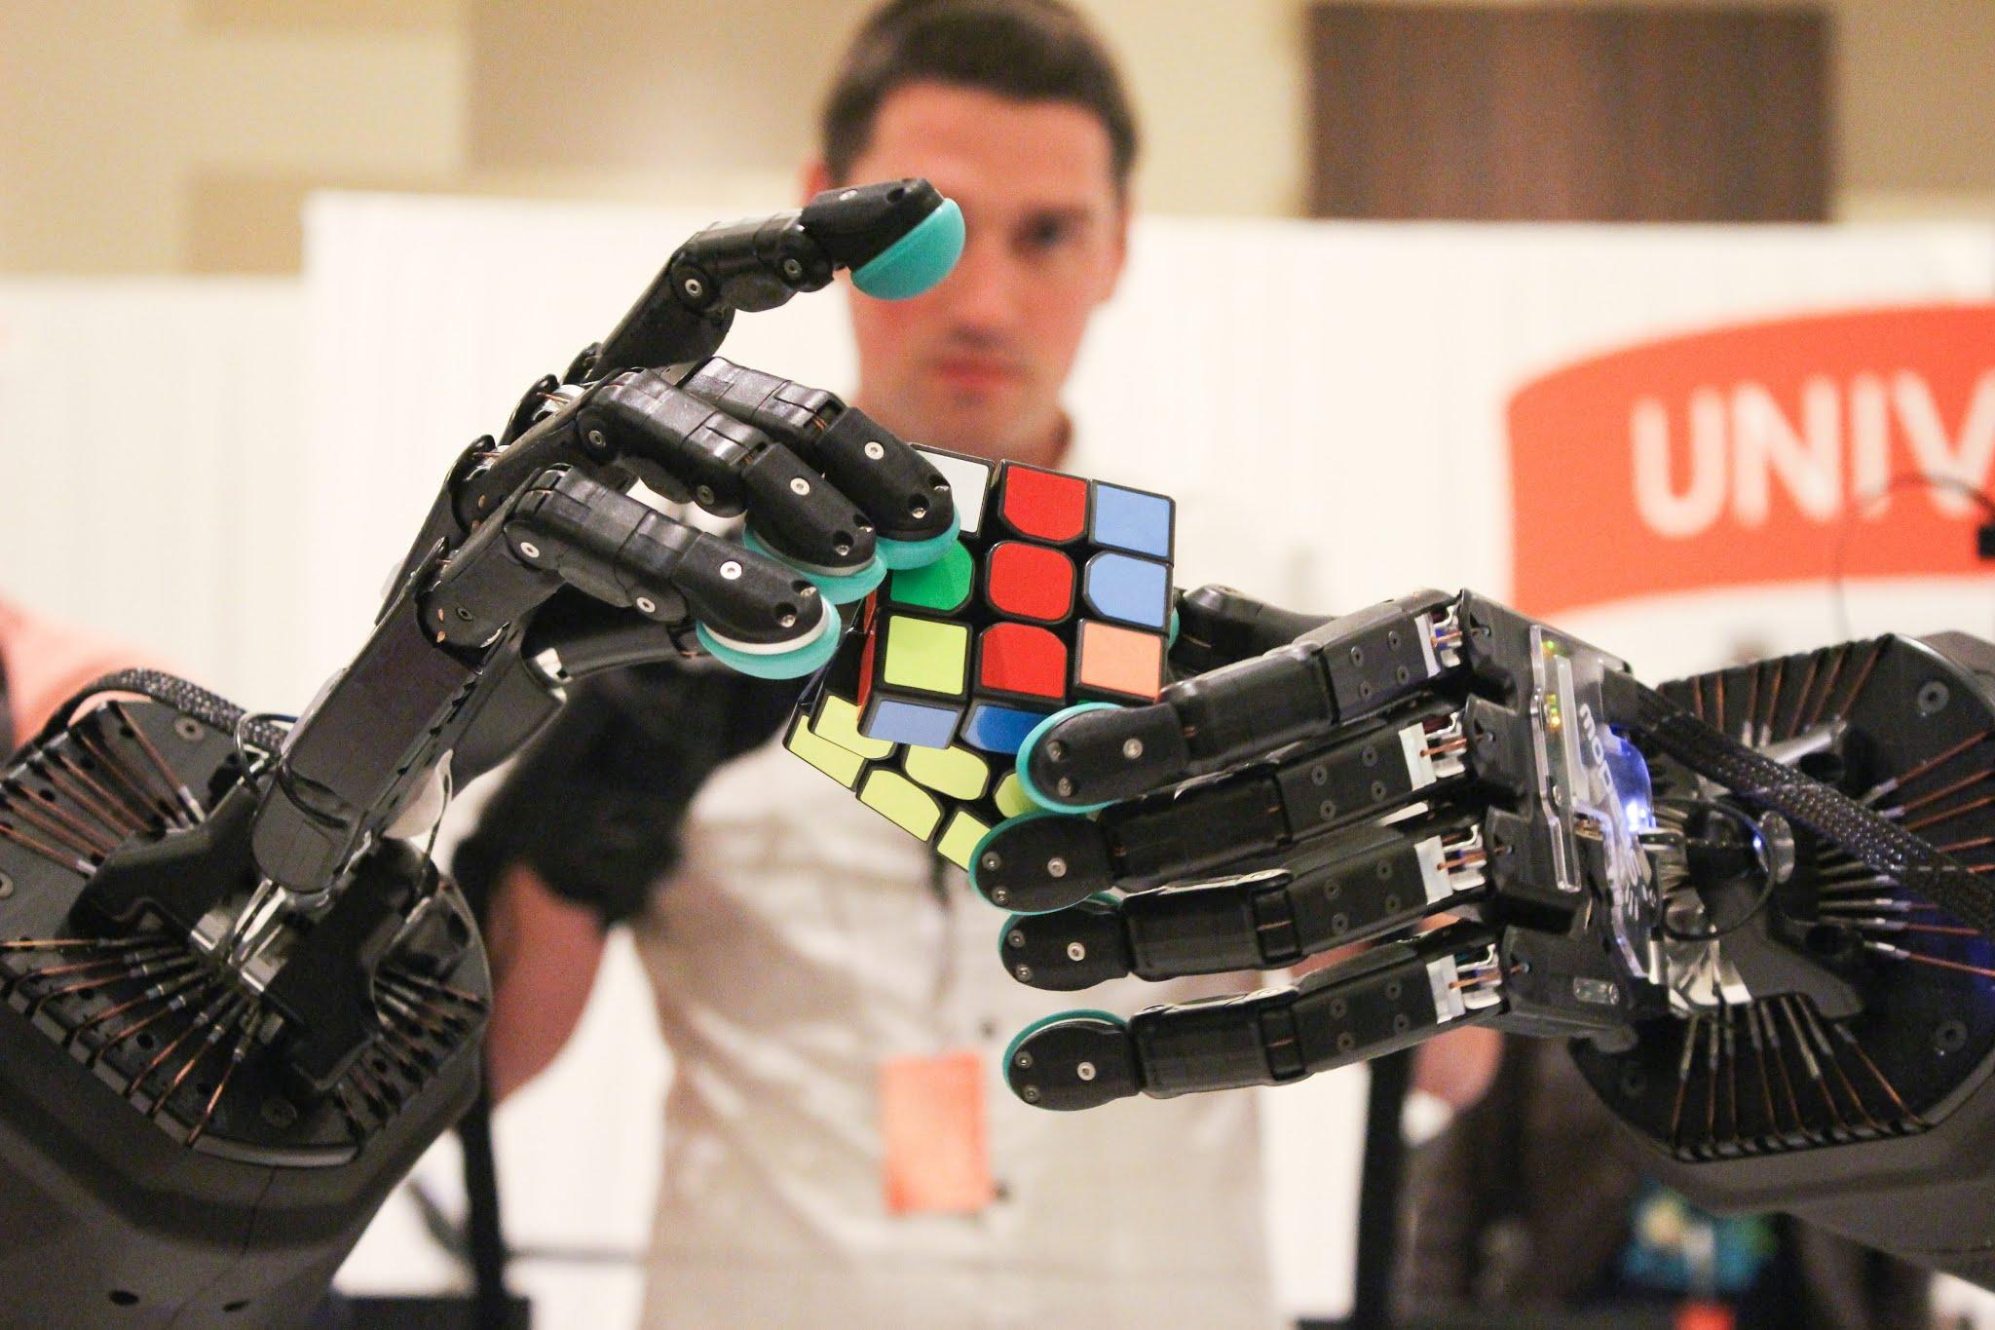
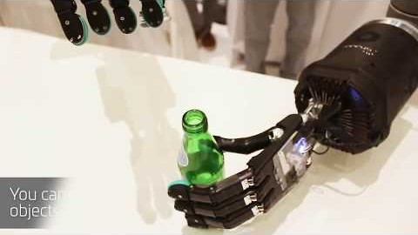

Shadow Teleoperation System
Shadow teleoperation system is the forerunner of today’s most advanced remote systems helping to transform work within radioactive environments by using human-like dexterous hands instead of human hands in glove boxes. The system has specifically been developed to create a pathway to raised safety standards and improved productivity.
An interesting video for our Tactile Telerobot.
A really revolutionary concept by ANA airlines combining Sadow Robot’s world-leading dexterous robotic hand with SynTouch’s biomimetic tactile sensors and HaptX’s realistic haptic feedback gloves.
www.celticnext.eu Radhika Gudipati Shadow Robot Company Ltd radhika@shadowrobot.com

Slide 3

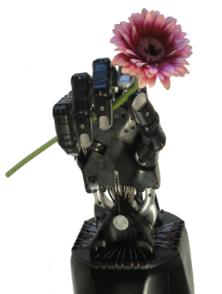
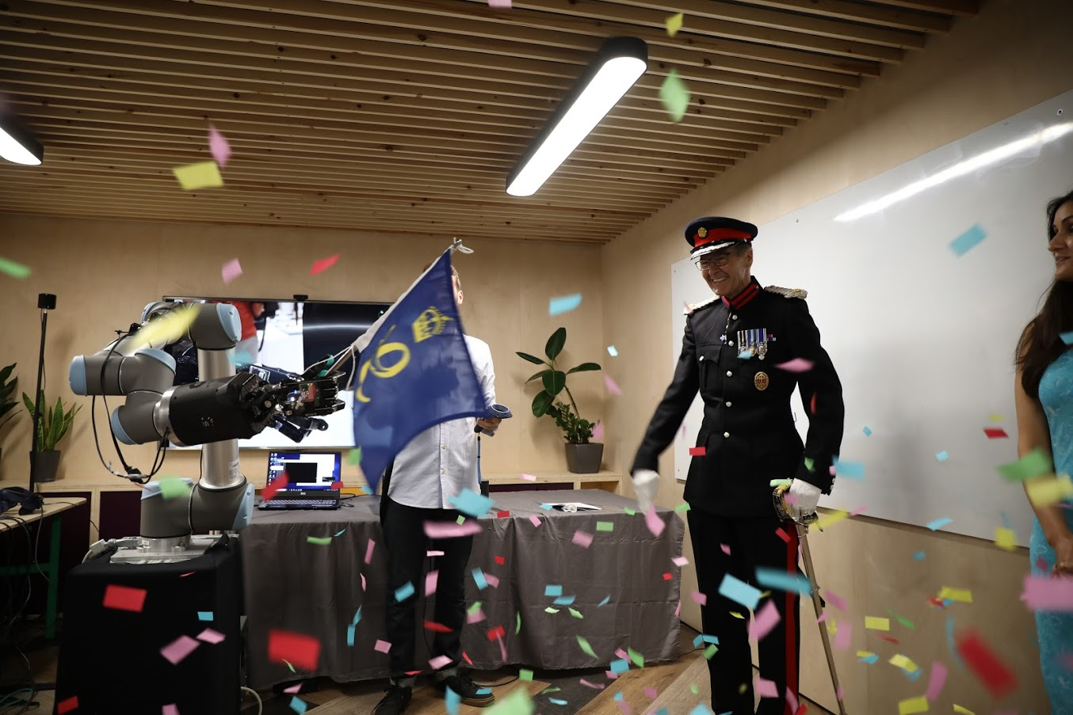
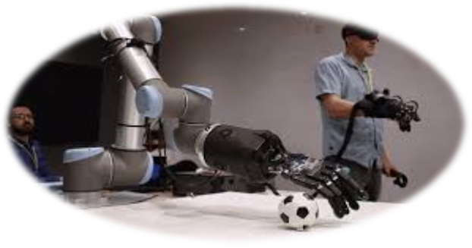
Shadow Robot Company
An SME, formally established in 1997 in London and we now have a subsidiary in Madrid
Longest running robotics company in UK, experts in grasping and manipulation.
Building and designing robot hands.
37 staff covering all BizDev processes, robotics hardware and software development.
Significant internal and collaborative R&D.
Global distribution and sales in research.
Global network of collaborators and partners.
Winners of the Queen’s Award for Innovation.
www.celticnext.eu Radhika Gudipati Shadow Robot Company Ltd radhika@shadowrobot.com

Slide 4

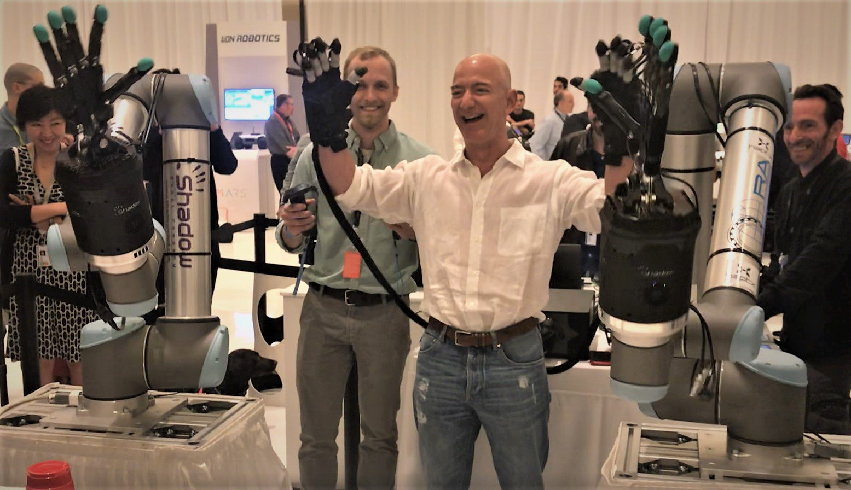
Potential applications of the teleoperation system
Market potential for the
teleoperation system:
Space
Oil & Gas
Pharma
Manufacturing automation
Inspection robotics
Bomb disposal
Deep sea engineering
Some of the benefits for extreme and hazardous environments:
Human levels of dexterity at ZERO risk
Safeguarding workers
Cost savings
Easing management anxiety and fear
More operational time and increased productivity
www.celticnext.eu Radhika Gudipati Shadow Robot Company Ltd radhika@shadowrobot.com

Slide 5
We would like to work with:
End users in nuclear, space, aerospace, oil & gas etc...
Vision System providers
AI/ML experts
Mobile robots
Tactile/Haptic sensing
Other application technologies needed to solve challenging use cases
Advanced robot arms for difficult spaces
We are looking to find a mutually beneficial collaboration where we can resolve challenges and provide innovative solutions for our partners while further enhancing our hardware and finding well-suited applications for our technology.
www.celticnext.eu Radhika Gudipati Shadow Robot Company Ltd radhika@shadowrobot.com

Slide 6
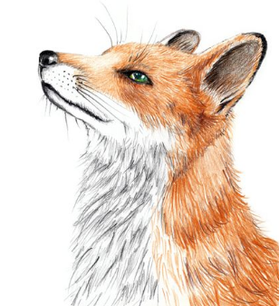
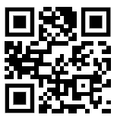
Contact Info
For more information and for interest to participate please contact:
Name: Radhika Gudipati
Email: radhika@shadowrobot.com
Shadow Robot Company Ltd
Unit 31, Spectrum House
32-34 Gordon House Rd
London NW5 1LP, U.K.
+44 (0)20 7700 2487
                Presentation available via:
                http://tiny.cc/proposalidea

Slide 7
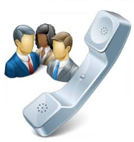
Join the follow-up Telco
11 September 16-16.30 CET
Meeting number : 959 812 825
Meeting password: xJJE4tmU
Link to join:
https://eurescom-meetings.webex.com/eurescom-meetings/j.php?MTID=md4eb4f0c663466e9143c8f0eea89b0c4
Join by phone
+49-6925511-4400 Germany toll
Global call-in numbers
Can't join the meeting?
www.celticnext.eu office@celticnext.eu

