Slide 1


CELTIC-NEXT
Innovate UK Summer Briefing
20th August 2019, London
Dependable Connectivity as a Service
Dr Keivan Navaie
Reader in Intelligent Cyber-Physical Systems
School of Computing and Communications
k.navaie@lancaster.ac.uk

Slide 2

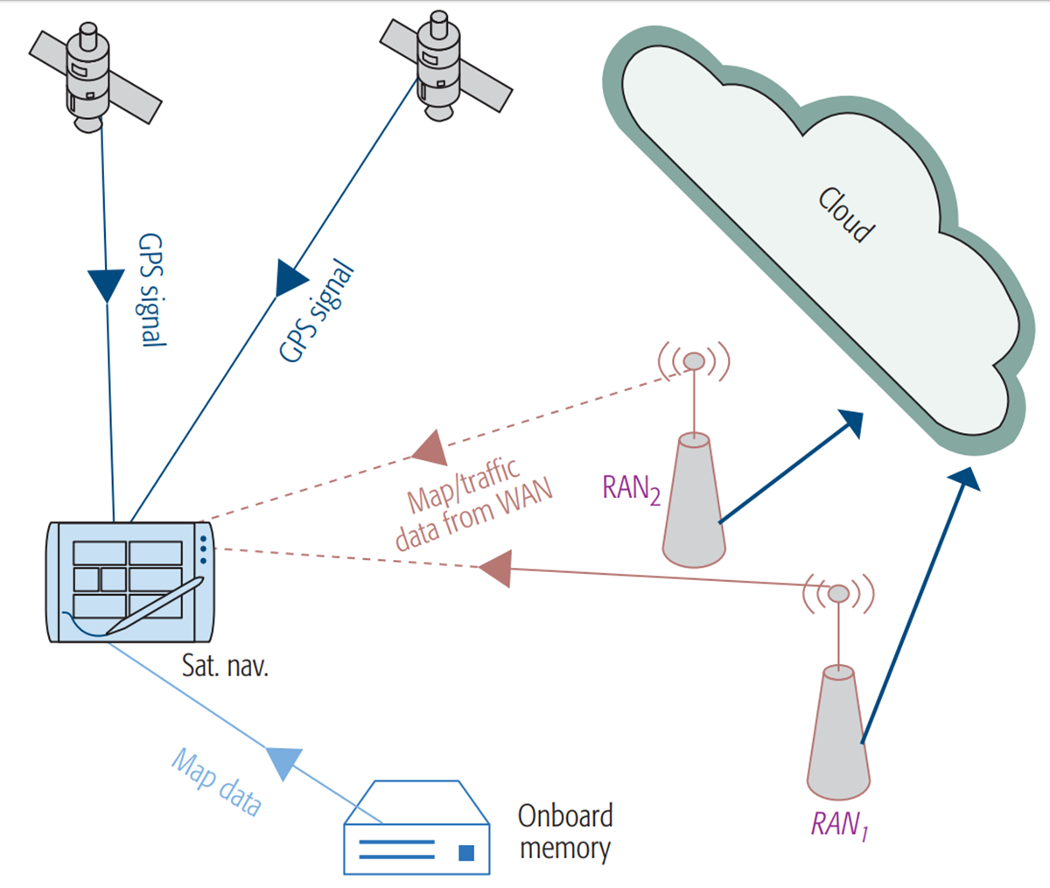
Network Resources
Dependability is subject to timely, reliable and secure exchange of information
Smart combination of resources in various network entities improves dependability
Added values comes from ecploiting otherwise unused resources
DaaS provides an Ecosystem and is an Enabler
www.celticnext.eu Proposal Name, Your Name, affiliation & e-mail of presenter

Slide 3
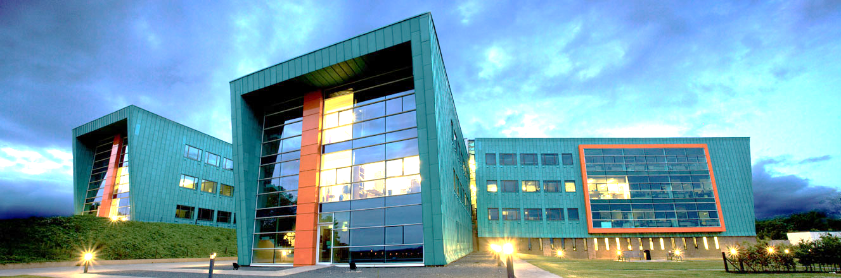
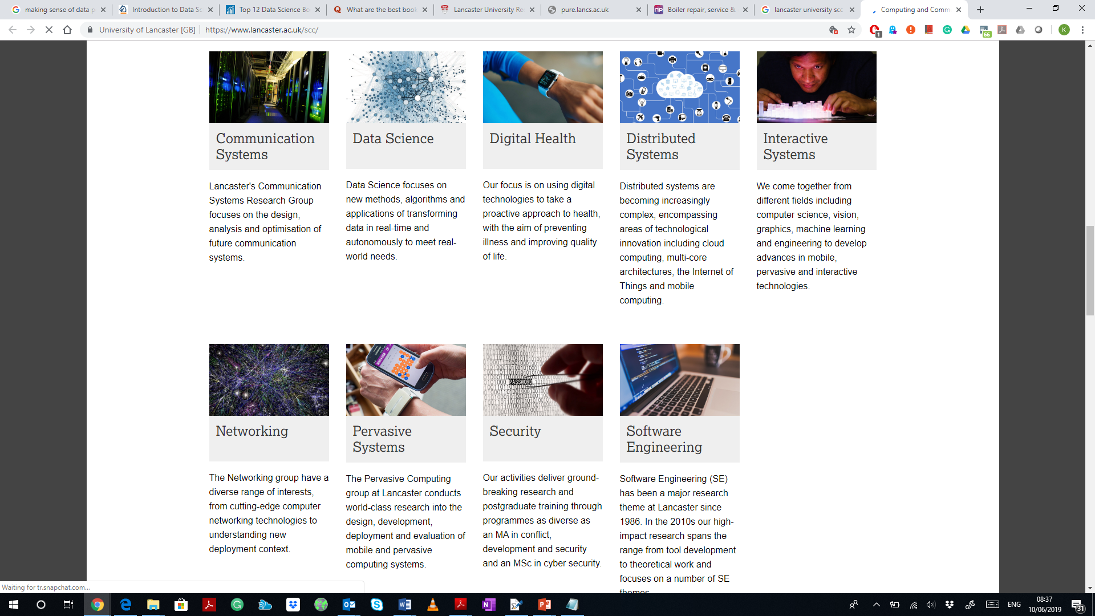
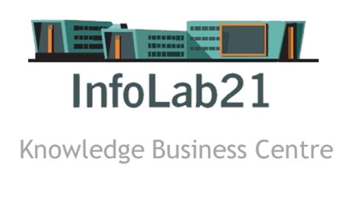
Organisation Profile
Top-ten (7th) in the UK ranking among computing science departments
A world-class teaching and research hub for computer science and communications systems
Multi-million research funding from EU and EPSRC
+100 academic staffs
+150 PhD and Postdocs
www.celticnext.eu Dependable-Connectivity-as-a-Service, K. Navaie, Lancaster University

Slide 4

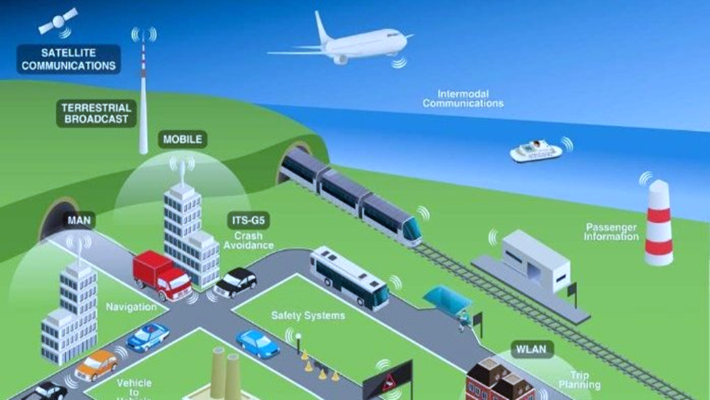
Dependability of Communications
Dependability is subject to timely, reliable and secure exchange of information
Major Enabler for mission-critical systems:
  Industry 4.0, E-Health, Mass-surveillance, Autonomous cars/robots, Smart cities
www.celticnext.eu Dependable-Connectivity-as-a-Service, K. Navaie, Lancaster University

Slide 5
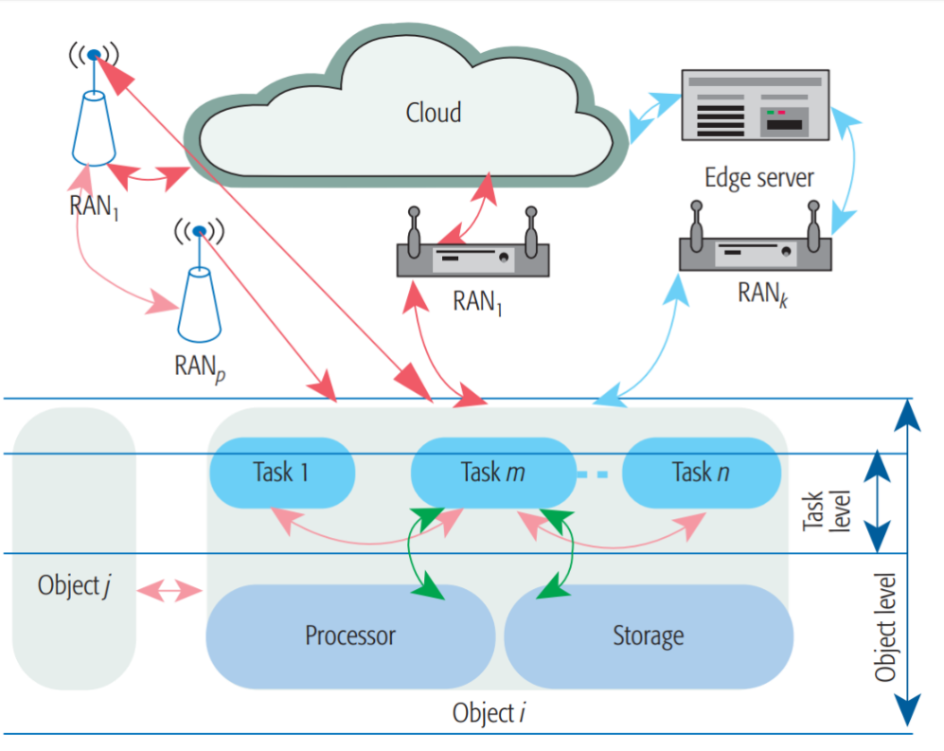
Dependable Connectivity (DeC)
DeC is collective system capability to provide task’s required information
Multi-level cooperation required among
  Tasks, objects, and RANs as well as on-board processing, etc.
  Aggregation of the available data on-board or at MEC
DeC is a task-centric and multi-faceted measure and can be provided through different combination of resources
www.celticnext.eu Dependable-Connectivity-as-a-Service, K. Navaie, Lancaster University

Slide 6
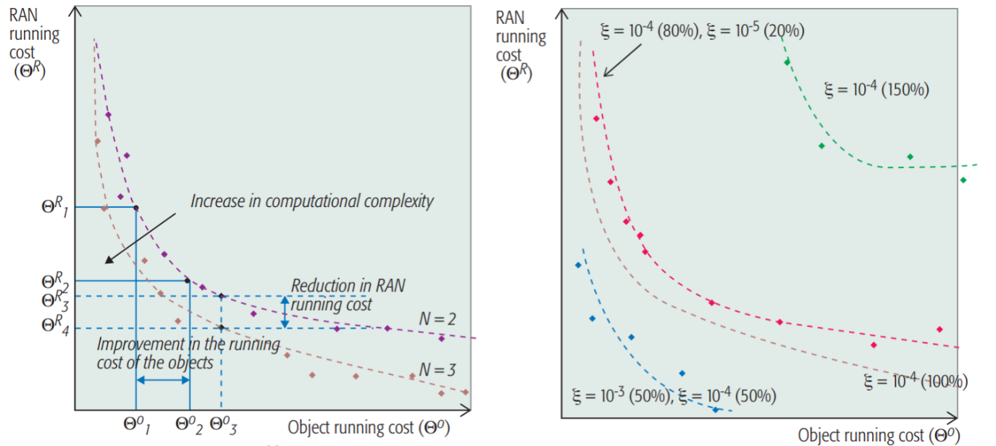
Heterogeneity, Dynamism, and Multiple Objectives
Each entity maximizes its own objective while network resources are limited
Multi-Objective optimization with multiple degrees of freedom and trade-offs
www.celticnext.eu Dependable-Connectivity-as-a-Service, K. Navaie, Lancaster University

Slide 7
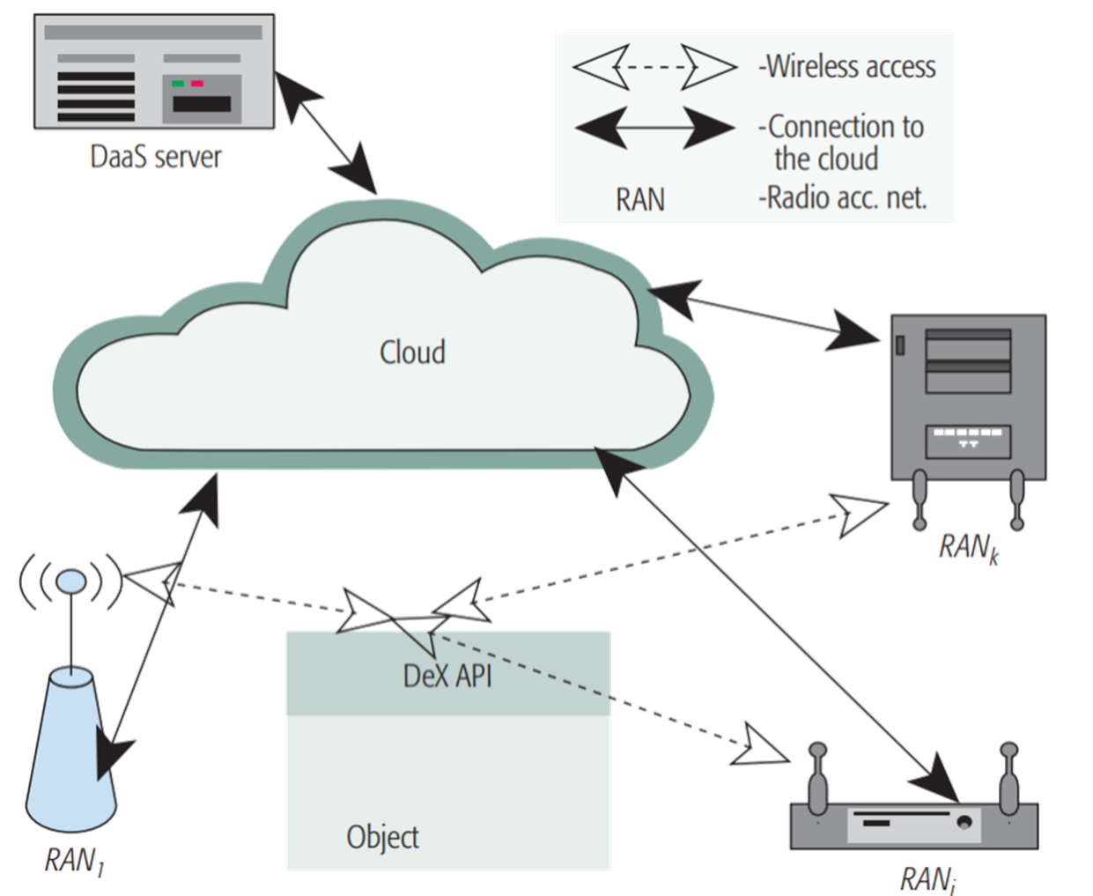
Dependable Connectivity as a Service: DaaS
WP1: Architecture Design and Concept development
WP2: System Design
WP3: Algorithm Design and Machine Learning
WP4:Modeling and Analysis
WP5: Implementation and Conformity
WP6: Coordination and Delivery
www.celticnext.eu Dependable-Connectivity-as-a-Service, K. Navaie, Lancaster University

Slide 8
Partners
Work Packages
WP1: Architecture Design and Concept development
WP2: System Design
WP3: Algorithm Design and Machine Learning
WP4:Modeling and Analysis
WP5: Implementation and Conformity
WP6: Coordination and Delivery
Partners Solicited
Wireless Network Technology
  Lancaster University, UK
  Manchester University, UK
Software Platforms
  Paremus, Ltd., UK
Mobile Edge Networks and Cloud/Fog Computing
Machine Learning and Algorithms
Optimization and Modelling
Project Coordination and Management
Testbed and Implementation
www.celticnext.eu Dependable-Connectivity-as-a-Service, K. Navaie, Lancaster University

Slide 9
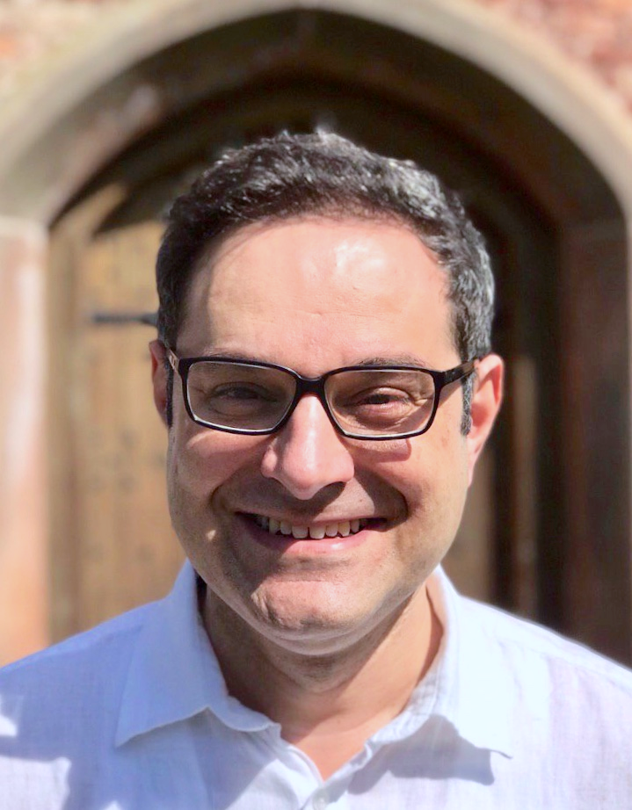
Contact Info
For more information and for interest to participate please contact:
Dr. Keivan Navaie, CEng, FIET, SFHEA
Reader in Mobile Computing
Email: k.navaie@Lancaster.ac.uk
Phone: +447776362160
Address: SCC, Lancaster University
Lancaster, LA14WA, UK

Slide 10

Join the follow-up Telco
12 September 10-10.30 CET
Meeting number: 954 275 024
Meeting password: BnJqzAvTLink
Join the Meeting:
https://eurescom-meetings.webex.com/eurescom-meetings/j.php?MTID=m7aad06a034b26d0893fc378014b25cf8
Join by phone
+49-6925511-4400 Germany toll
Global call-in numbers
Can't join the meeting?
www.celticnext.eu office@celticnext.eu

